Slide 1


Copyright © www.ITbodhi.com

Slide 2
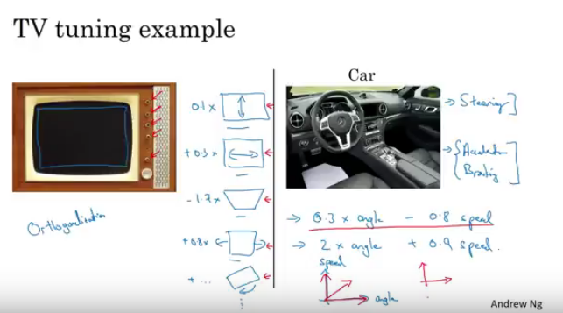
Orthogonalization
Copyright © www.ITbodhi.com

Slide 3
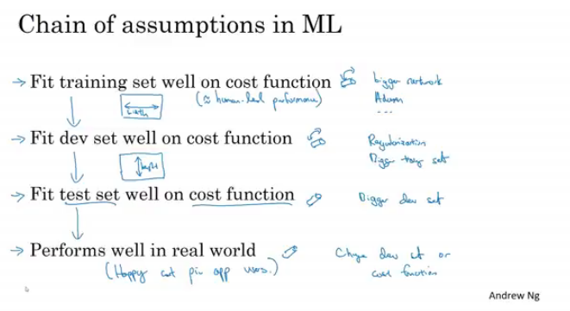
Orthogonalization
Copyright © www.ITbodhi.com

Slide 4
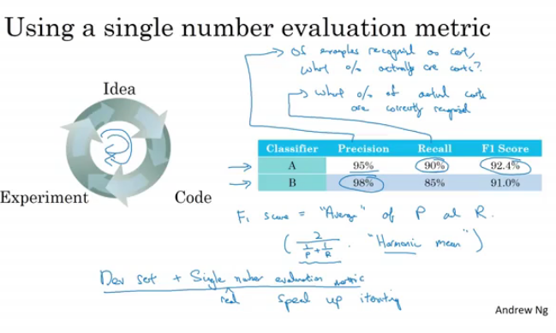
Single Number evaluation metric
Copyright © www.ITbodhi.com

Slide 5
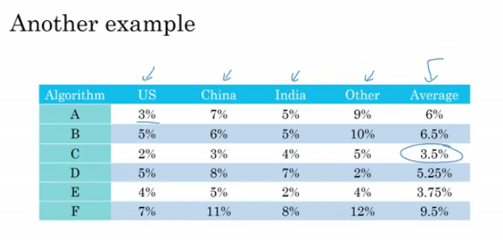
Single Number evaluation metric
Copyright © www.ITbodhi.com
Notes:
Images from different regions and error during classification

Slide 6
Satisficing and Optimizing Metrics
Copyright © www.ITbodhi.com
Notes:
Images from different regions and error during classification

